Slide 1
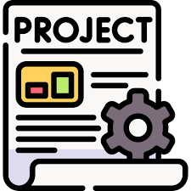



Slide 2
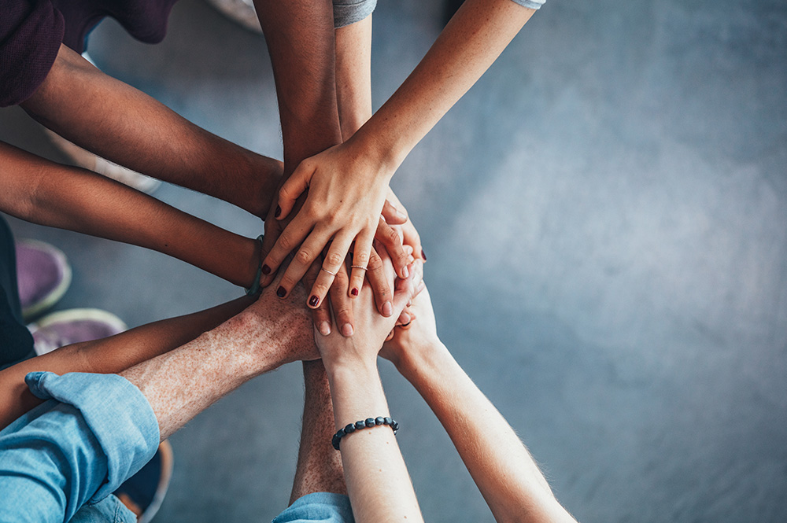
ENSE 281 GROUP PROJECT
Project Description: Design & Develop A Small To Medium Scaled, Web-Based Software Application
WINTER 2026 - GROUP E
Ali Abdullah
Nyabijek Gatdet
Chiemego Emmanuel
Chinedu Godswill

Slide 3


Slide 4

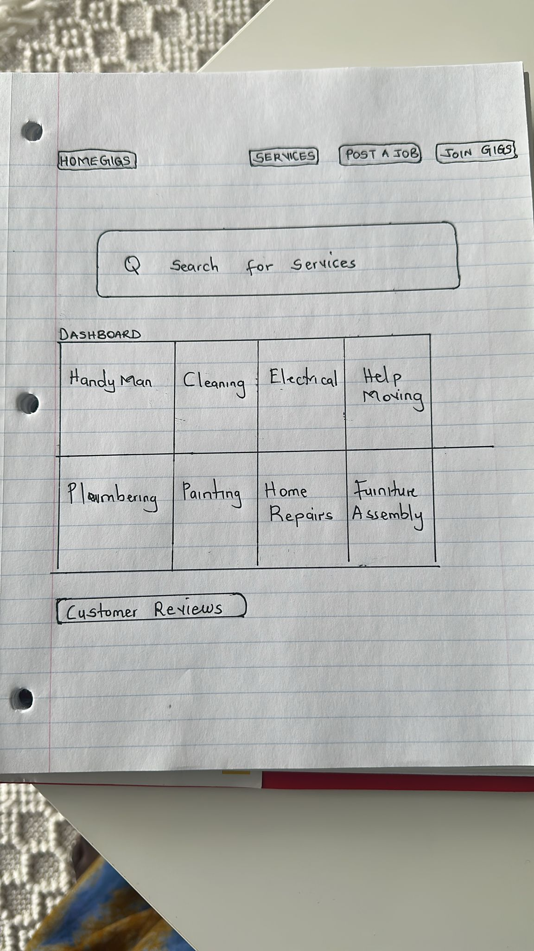
LOW FIDELITY PROTOTYPES
Determine system prerequisites and system designing
Three low fidelity prototypes (paper and pencil) to start planning
Lofi Prototype 01

Slide 5
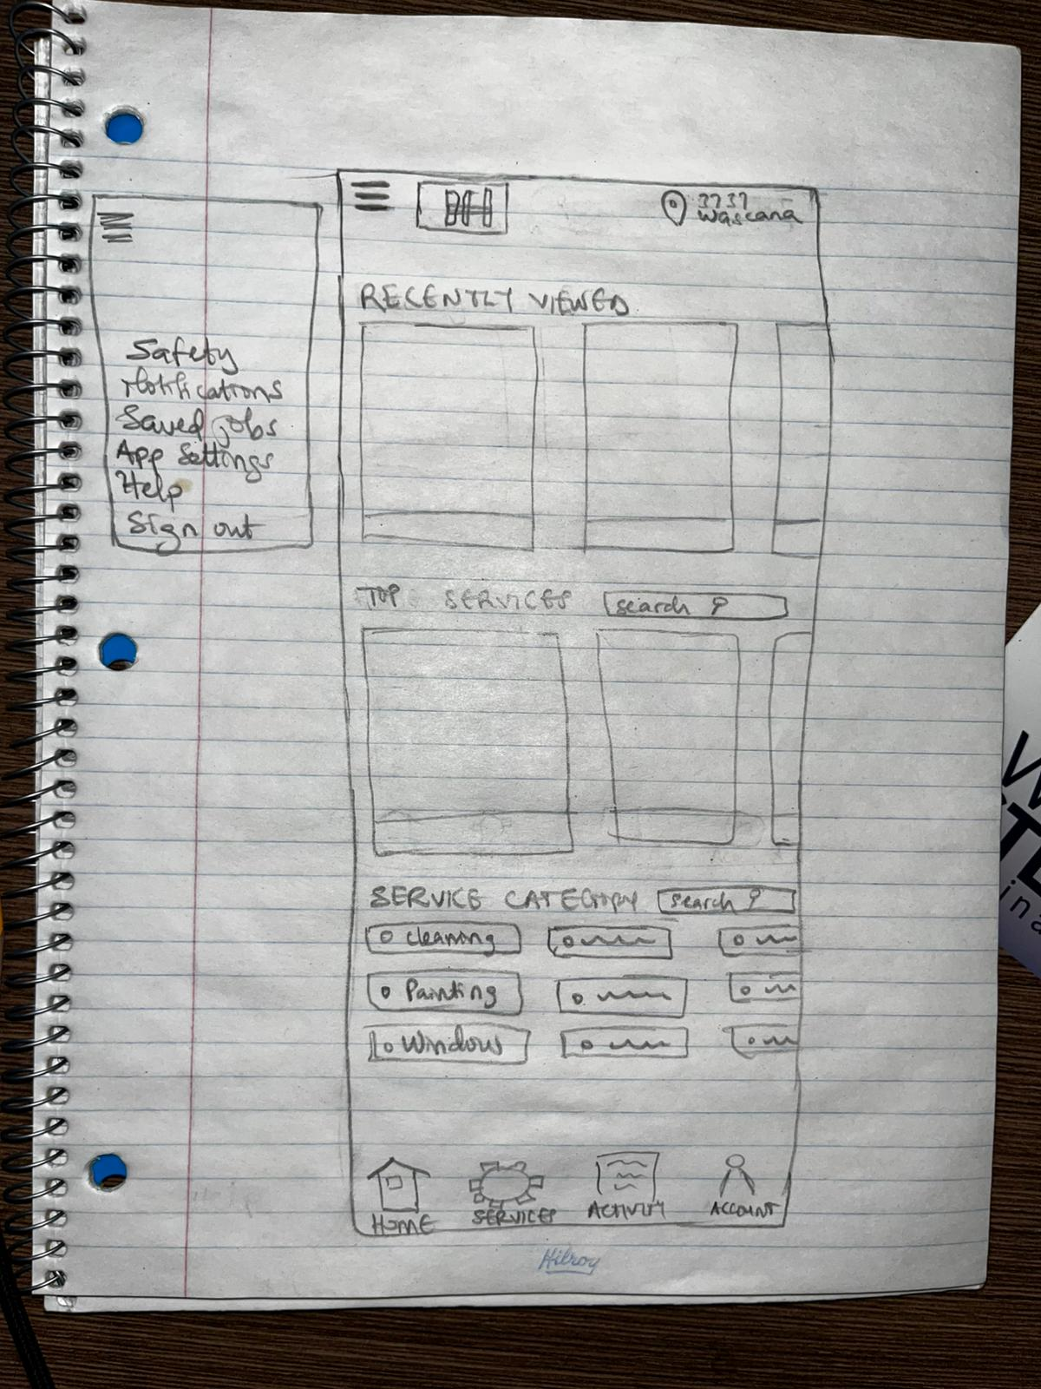
LOW FIDELITY PROTOTYPES
Determine system prerequisites and system designing
Three low fidelity prototypes (paper and pencil) to start planning
Lofi Prototype 02

Slide 6
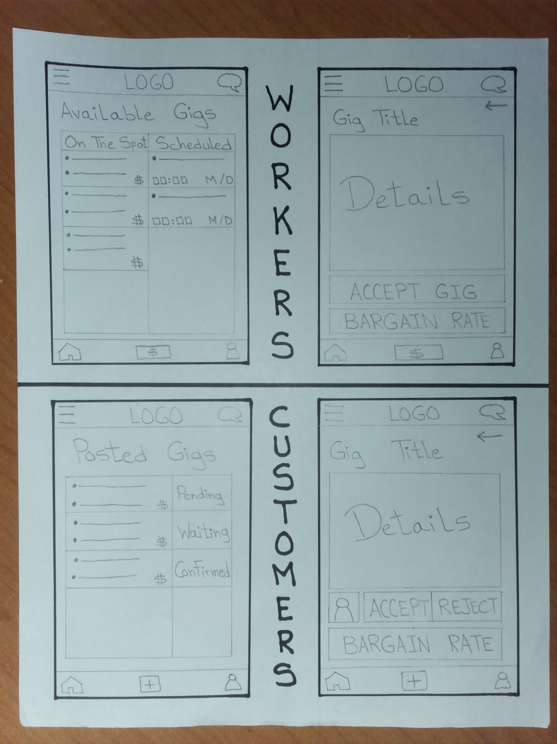
LOW FIDELITY PROTOTYPES
Determine system prerequisites and system designing
Three low fidelity prototypes (paper and pencil) to start planning
Lofi Prototype 03

Slide 7

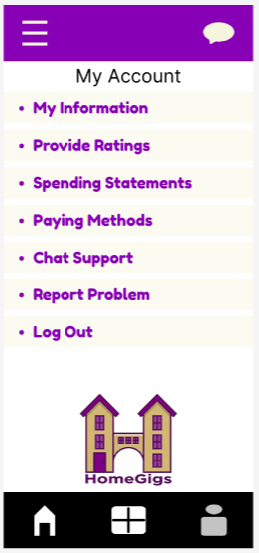
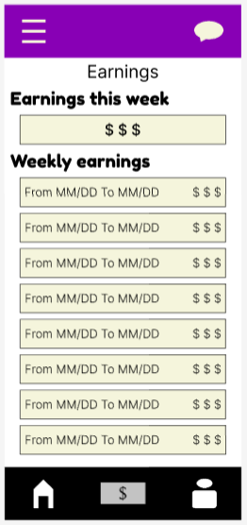
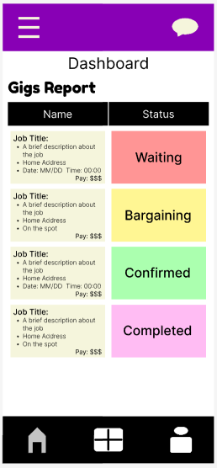
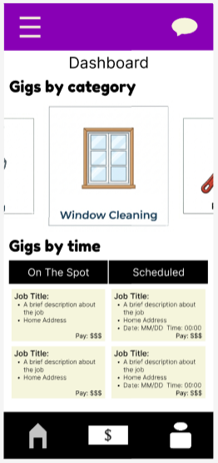

HIGH FIDELITY PROTOTYPE
One high fidelity prototype using Figma (Design and function) and Gemini (AI to create photos)
Functional MVPs:
Posting gigs by customers
Accepting gigs by worker
Contact between both sides
Price bargaining ability
Colour Scheme: Purple & Beige
ENSE 281 - Group E - High Fidelity Prototype Link

Slide 8
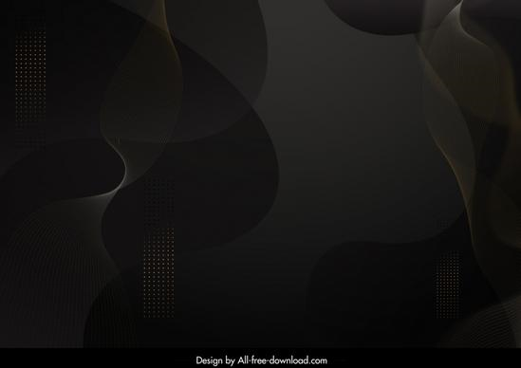
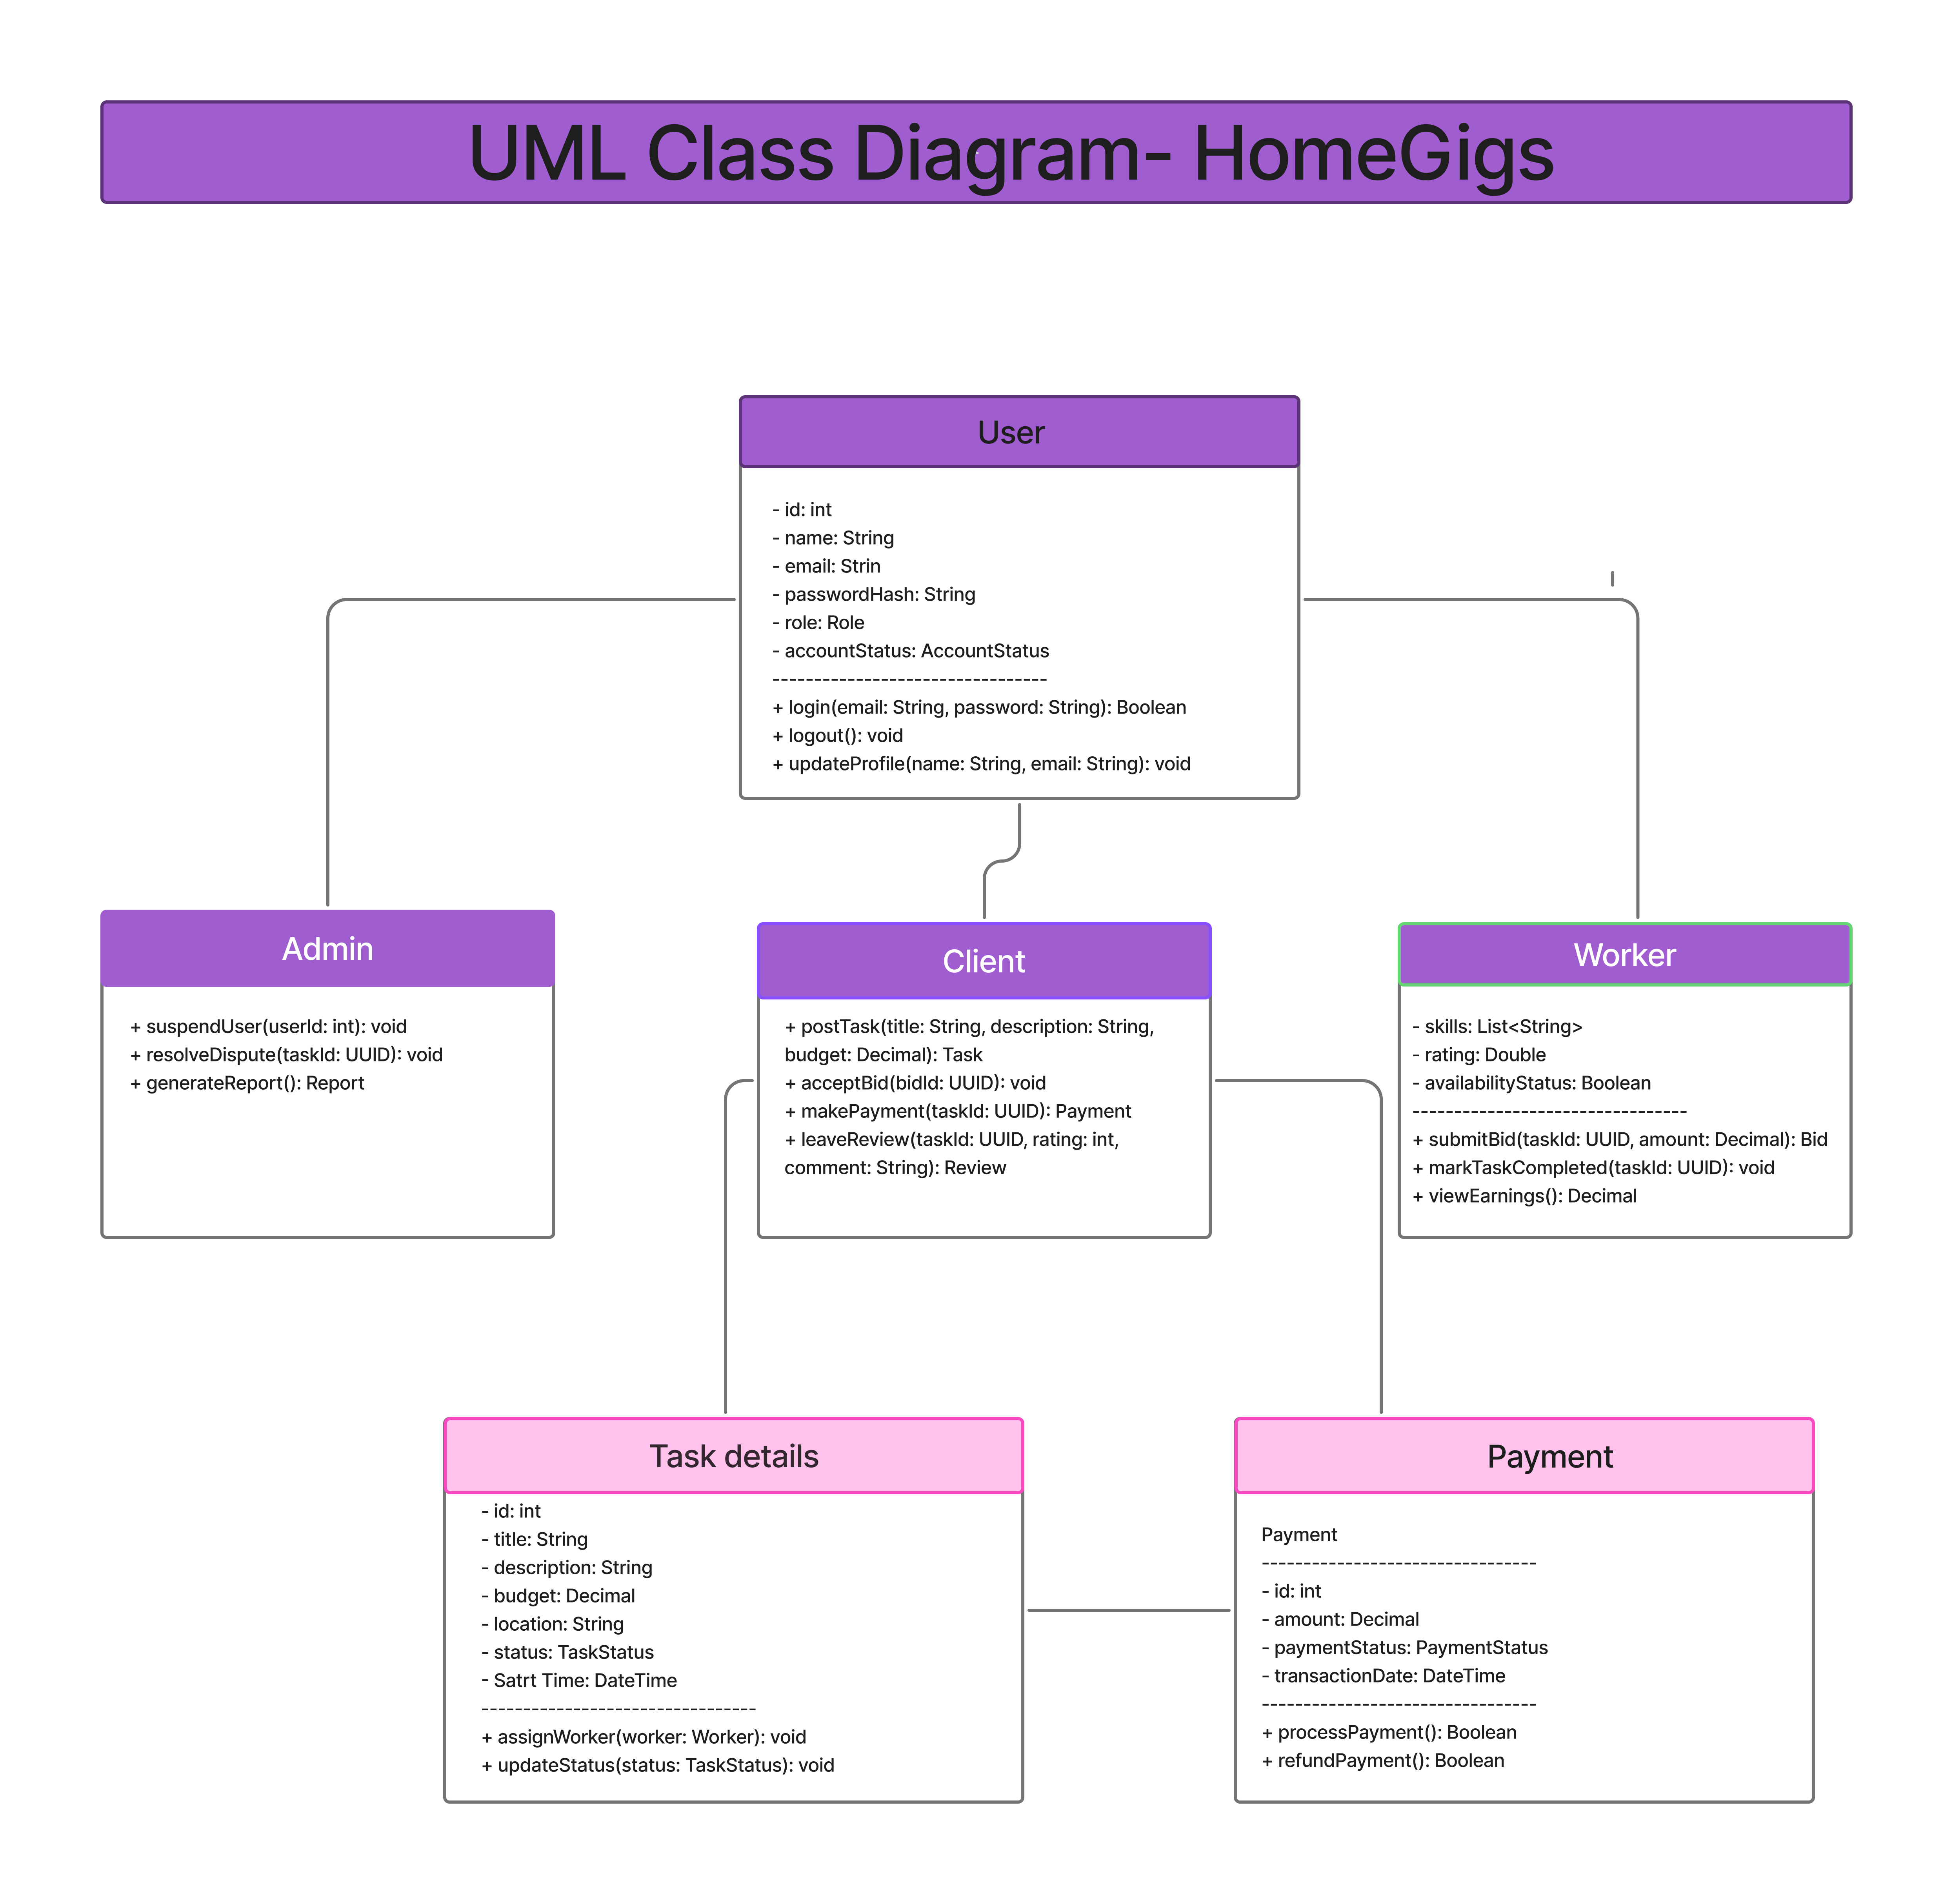
UML DIAGRAMS
A Unified Modeling Language (UML) diagram is a standardized visual representation used to model the structure, behavior, and interactions of software systems and business processes.
It acts as a blueprint, allowing developers and stakeholders to plan, document, and communicate complex system architectures through visual, rather than just text-based.

Slide 9
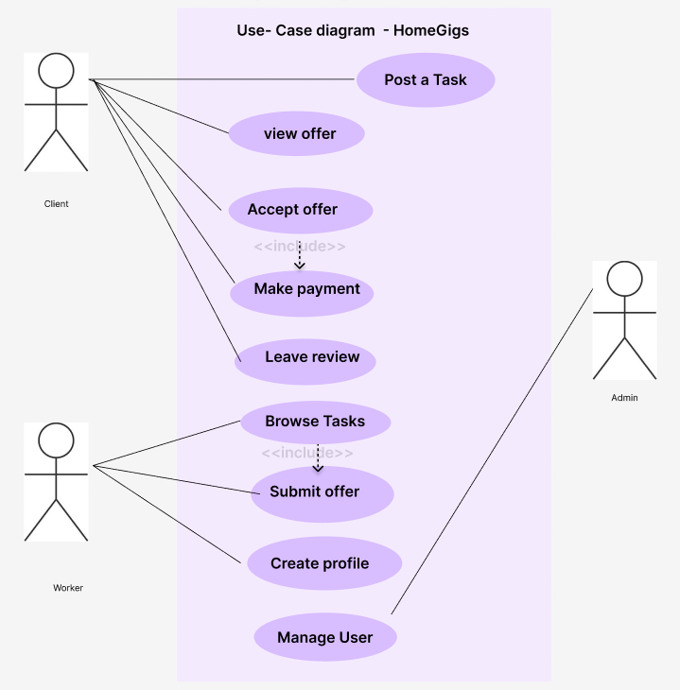
UML DIAGRAMS
A Unified Modeling Language (UML) diagram is a standardized visual representation used to model the structure, behavior, and interactions of software systems and business processes.
It acts as a blueprint, allowing developers and stakeholders to plan, document, and communicate complex system architectures through visual, rather than just text-based.

Slide 10
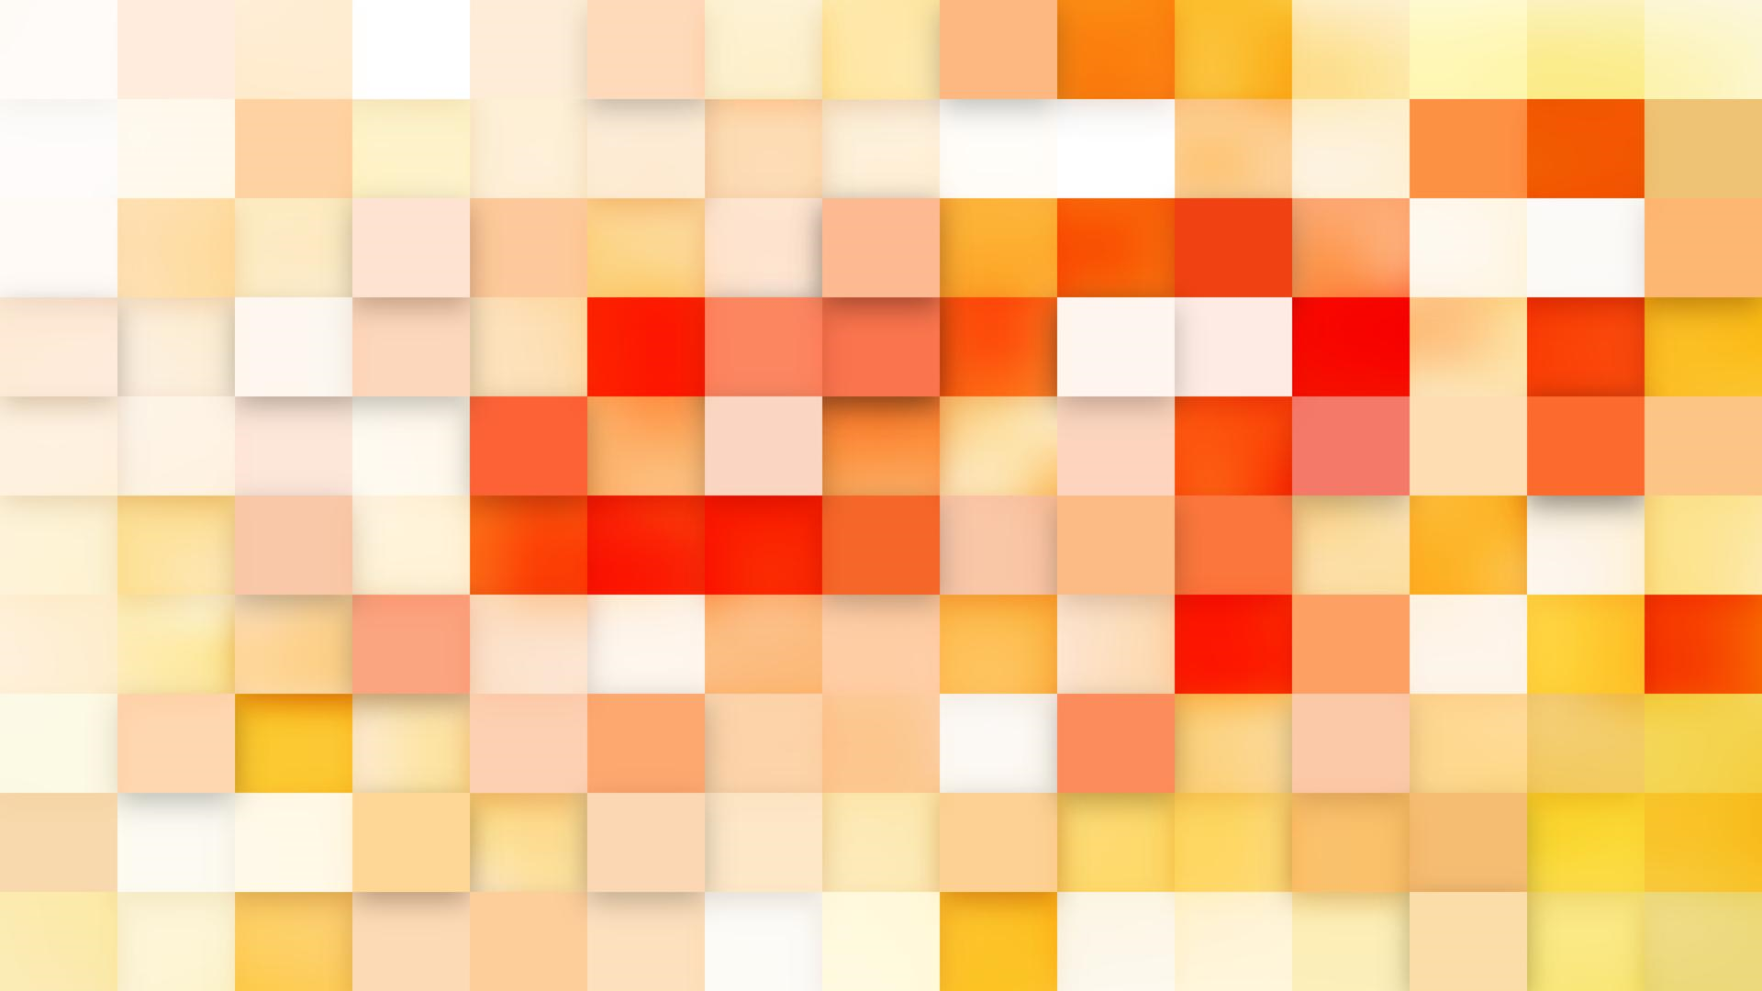
SELF REFLECTION
Feelings about activity:
Interesting stuff , Real life growth , Business opportunity
Most liked part:
Designing
Least liked part:
Tons of documentation , Time conflicts with team members
Proud about project:
Learning to be on the same page , Countless efforts
Lessons learned:
Documents create a common ground , Accountability for members
Experience going forward:
Do not take time for granted , Stay connected
Help needed further:
Improve development skills , Manage time and material efficiently

Slide 11

Any Questions?
Any Suggestions?
Any Specifications?
Any Recommendations?

Slide 12




